Slide 1
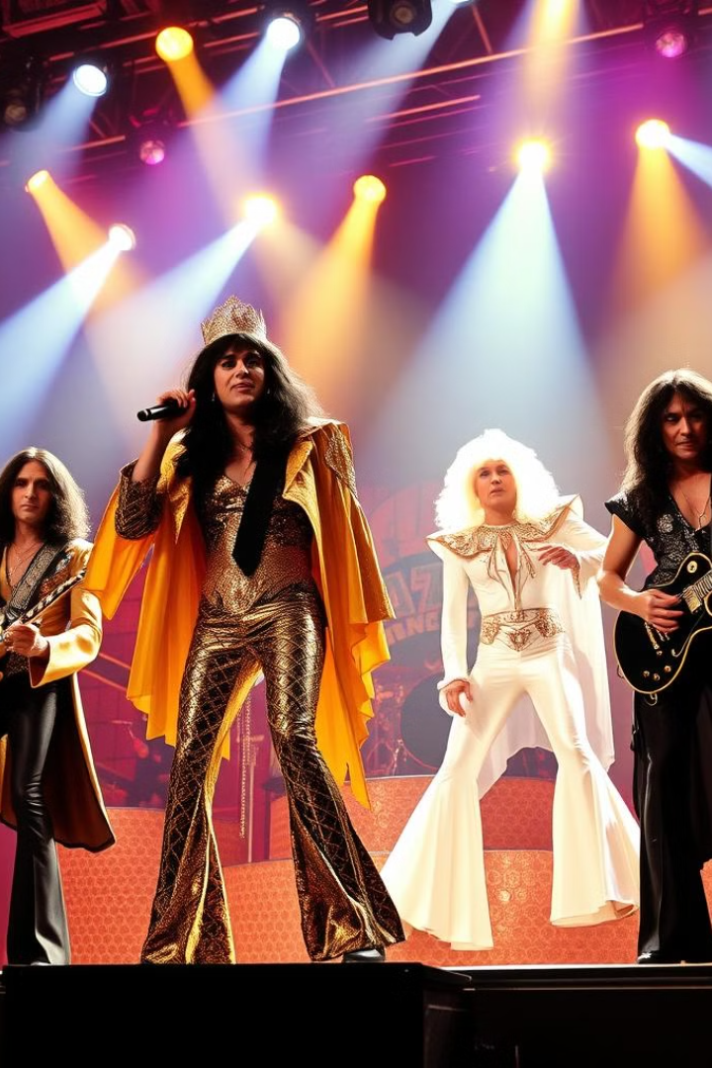
Queen: Rock Royalty
Legendary band formed in London, 1970.
Freddie Mercury, Brian May, Roger Taylor, John Deacon.
Yehor Burlachenko

Slide 2
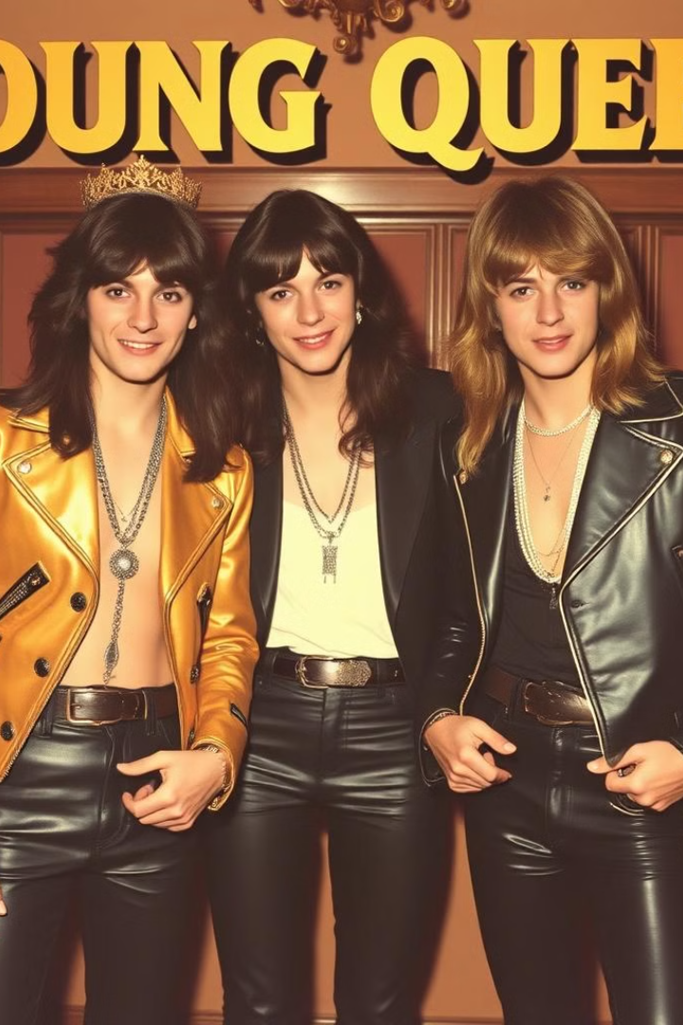
The Birth of Queen
1
Smile
Brian May and Roger Taylor's original band.
2
Mercury's Influence
Encouraged complex sounds and theatrical performances.
3
Queen Forms
Mercury joins, renames band, Deacon completes lineup.

Slide 3
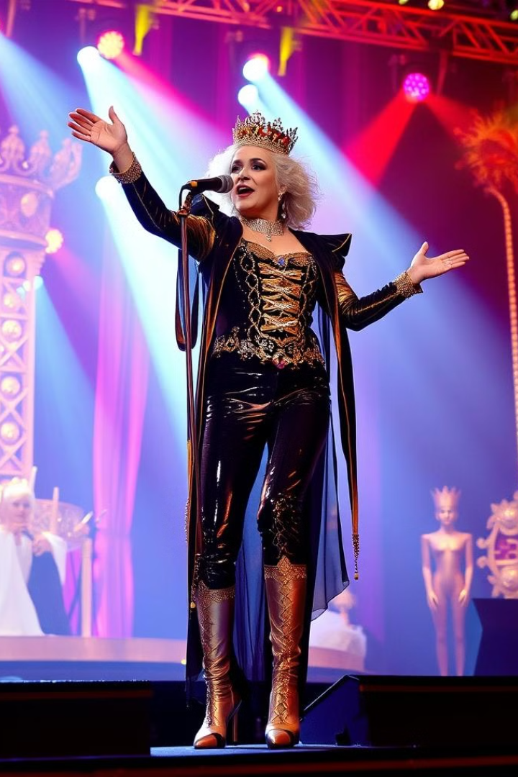



Evolution of Sound
Early Years
Progressive rock, hard rock, heavy metal influences.
Transition
Shift towards mainstream, mass-appealing style.
Mature Sound
Arena rock and pop rock elements.

Slide 4


Rise to Fame
Queen II (1974)
1
First taste of chart success.
2
Sheer Heart Attack (1974)
Continued momentum and popularity growth.
A Night at the Opera (1975)
3
Global fame with 'Bohemian Rhapsody'.

Slide 5
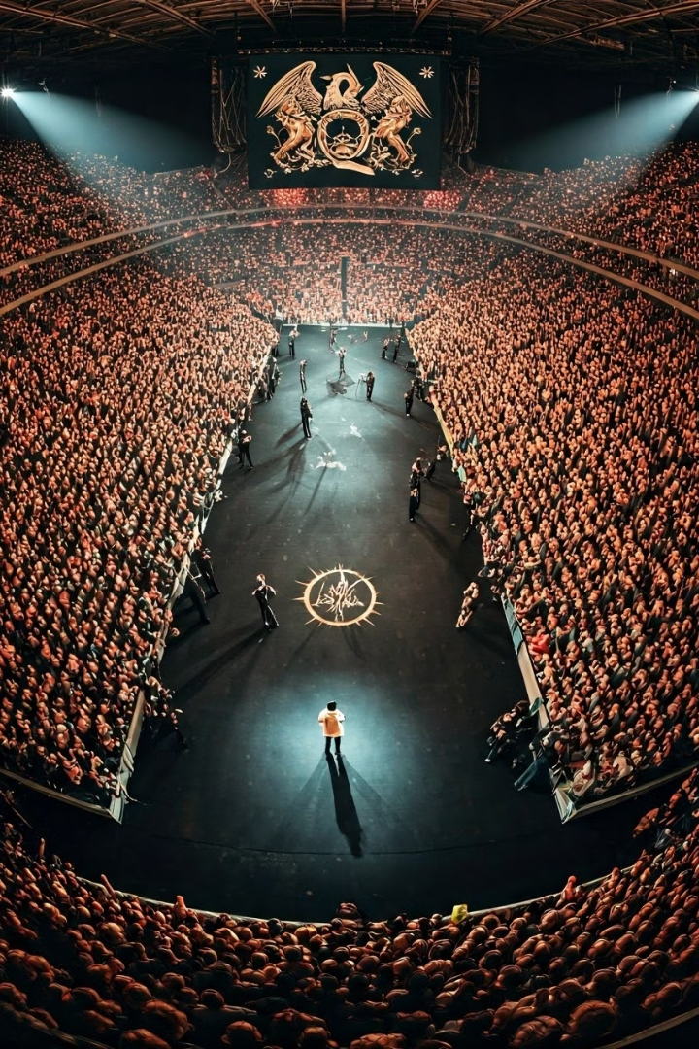



Iconic Anthems
We Will Rock You
Iconic stadium anthem, still played worldwide.
We Are the Champions
Triumphant song, staple at sporting events.
Another One Bites the Dust
Best-selling track, showcasing versatility.

Slide 6
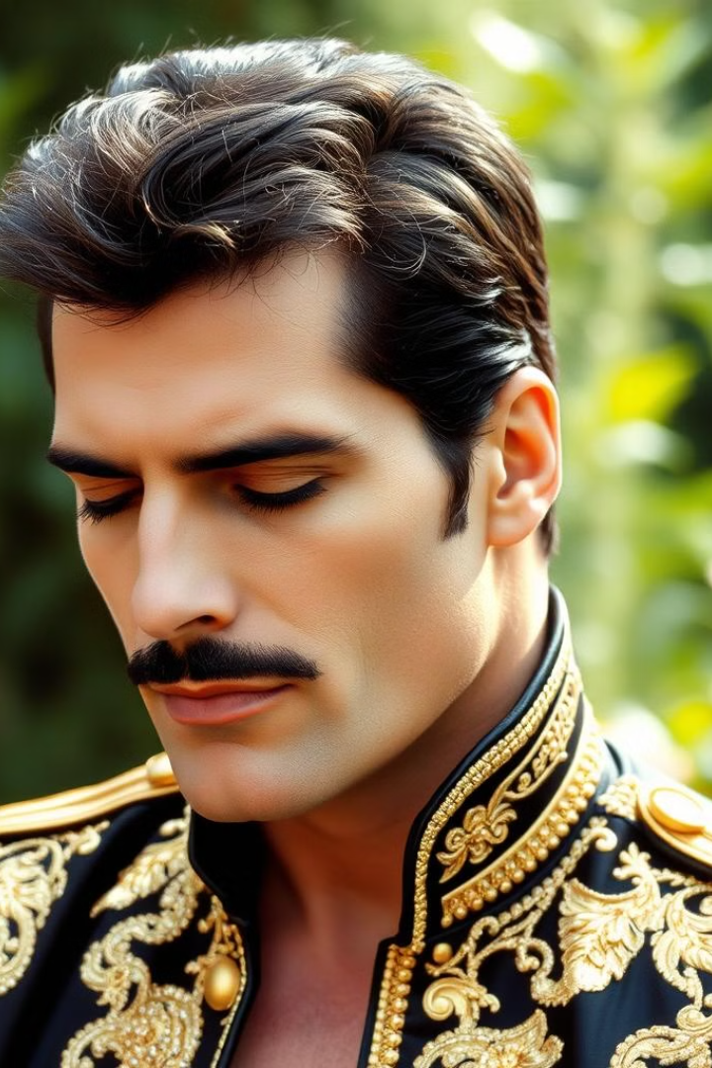
Mercury's Final Years
1987
1989-1991
Mercury diagnosed with AIDS, keeps it private.
Released 'The Miracle' and 'Innuendo' albums.
November 23, 1991
November 24, 1991
Mercury announces illness publicly.
Mercury passes away, leaving a lasting legacy.

Slide 7
Queen's Enduring Legacy
Record Sales
Awards
Continuing Impact
250-300 million albums sold globally.
Brit Award, Rock and Roll Hall of Fame.
Queen + Adam Lambert tours, inspiring new generations.

